Slide 1
Gencho stoev “THE Price of gold”
Notes:
NOTE:
To change the image on this slide, select the picture and delete it. Then click the Pictures icon in the placeholder to insert your own image.

Slide 2
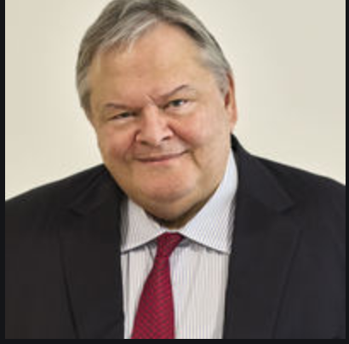
Gencho Stoev, the first winner of the big all-Balkan literary award Hemus
the Balkan Nobel Prize, presented to him by the Minister of Culture of Greece personally on December 16, 2000 in Thessaloniki, for his novel The Price of Gold.

Slide 3
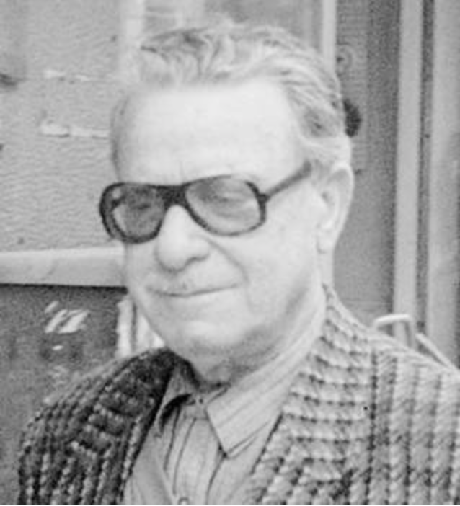
KOSTAS SIAPERAS, the Greek translator

Slide 4
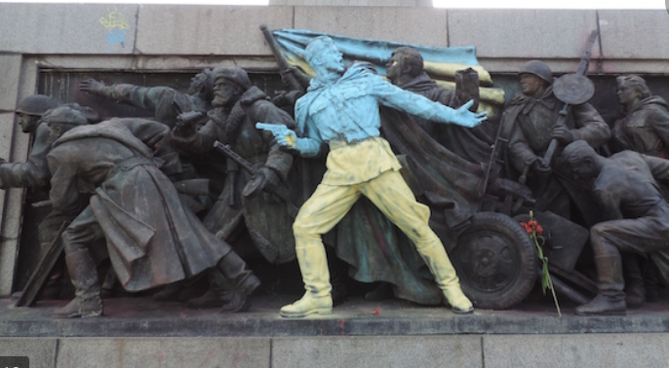
GENCHO STOEV, the anti-conformist

Slide 5
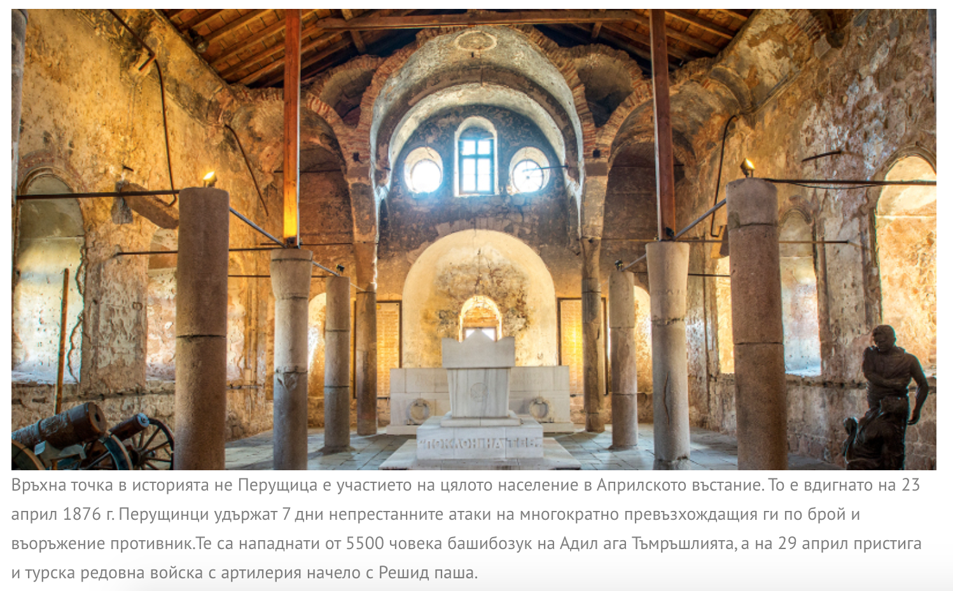
PERYSHTITSA, nest of heroes

Slide 6
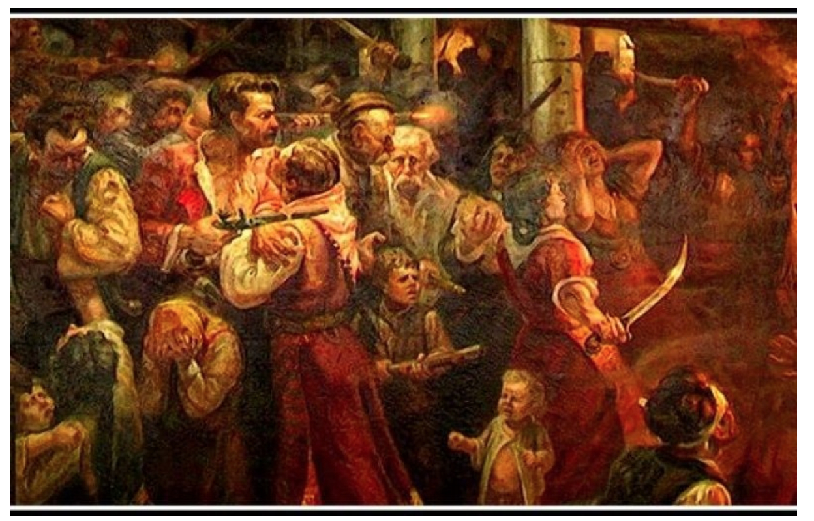
THE APRIL UPRISING OF 1876

Slide 7
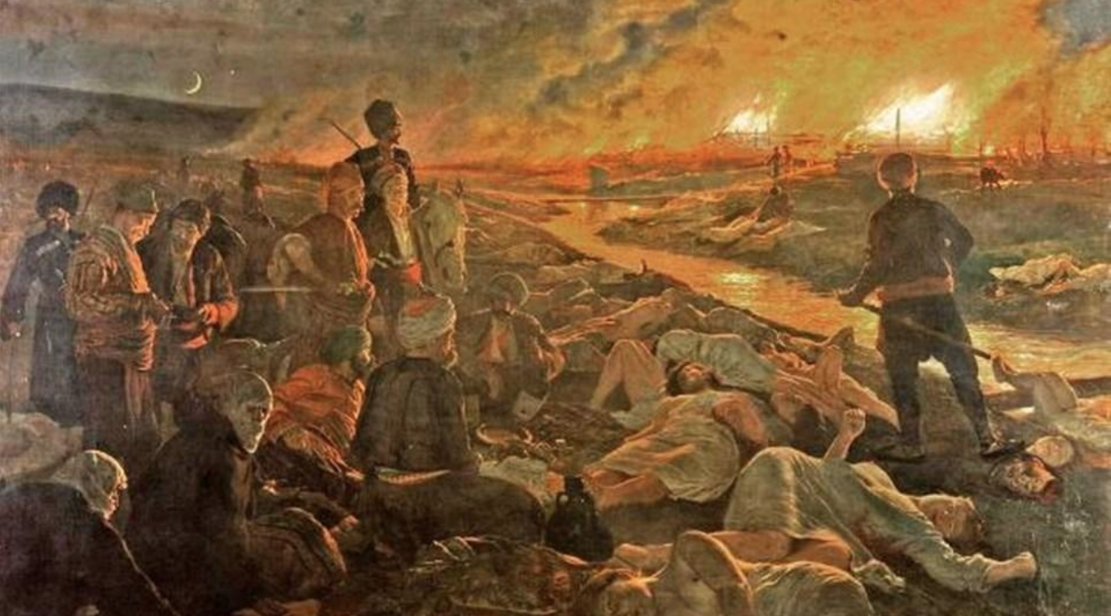
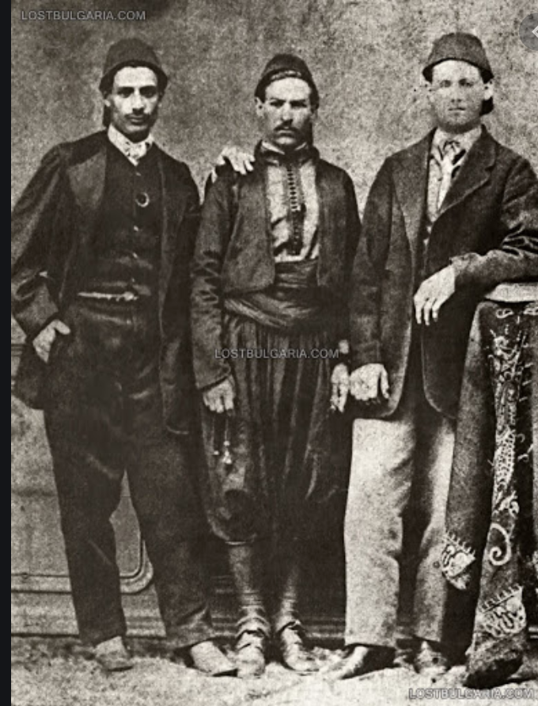
Heroism and tragedy in the April epic

Slide 8
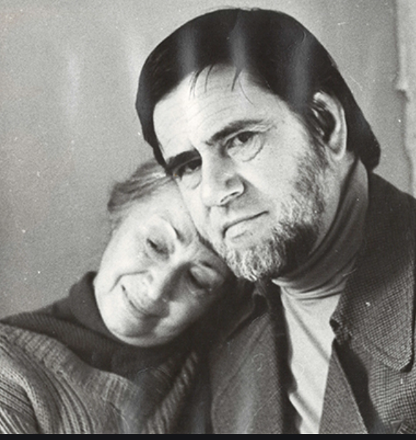
THE PRICE OF FREEDOM

Slide 9
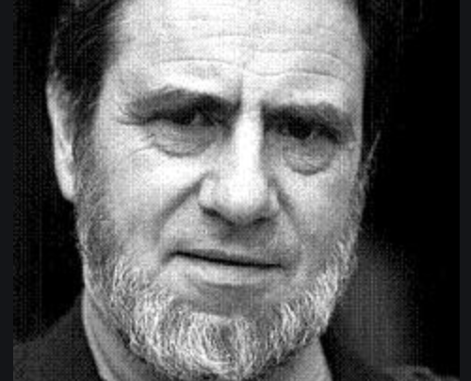
the price of dignity

